Slide 1
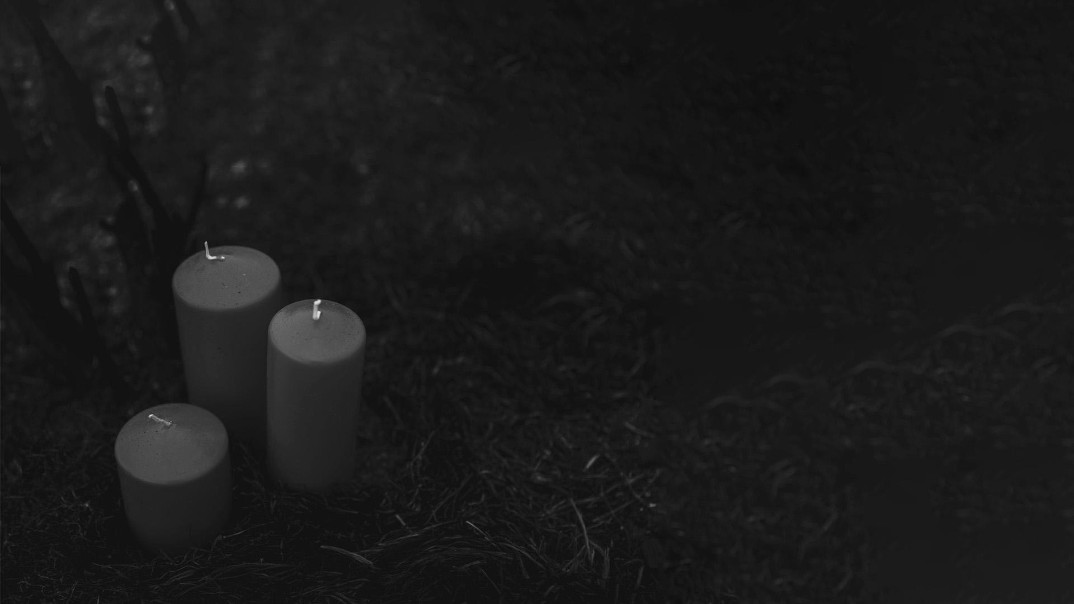


THAI GHOSTS
3D pose estimation
Team Red - Computer Vision

Slide 2
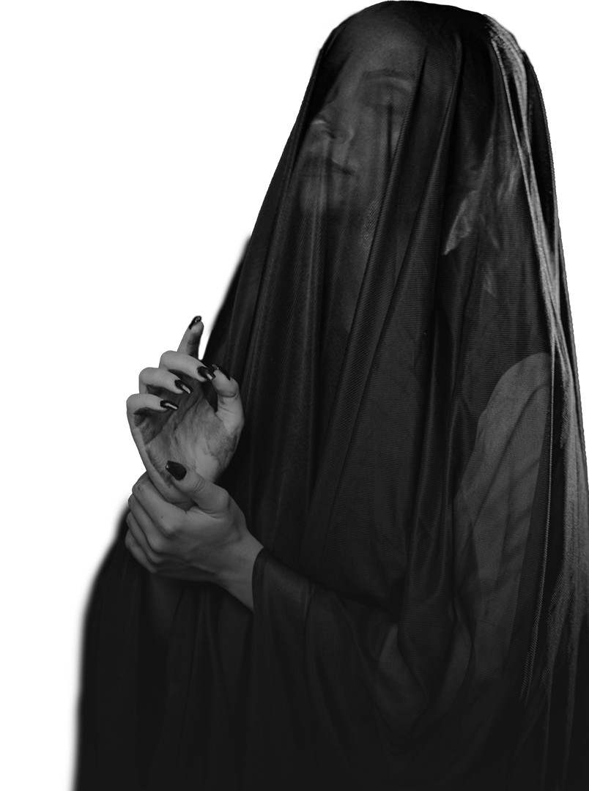
01
02
03
04
About Topic
Process & Code Overview
Chosen Film & Media
Demonstration Videos

Slide 3
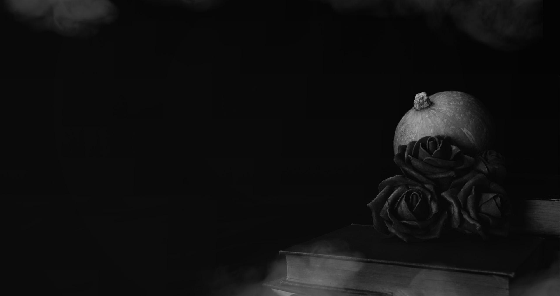
01
About

Slide 4
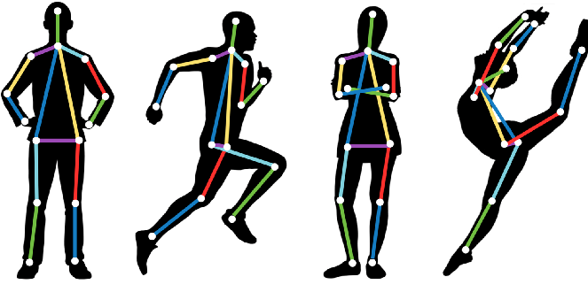
INTRODUCTION
Thai Arts & Culture: Ghosts in Thai Folklore
Objective: To analyze body and face movements in scenes featuring ghosts from Thai horror films, using 3D pose estimation.
Clips Used: 9 clips from popular Thai horror films.
Technology: OpenCV, MediaPipe, 3D pose estimation, Tkinter for GUI.

Slide 5
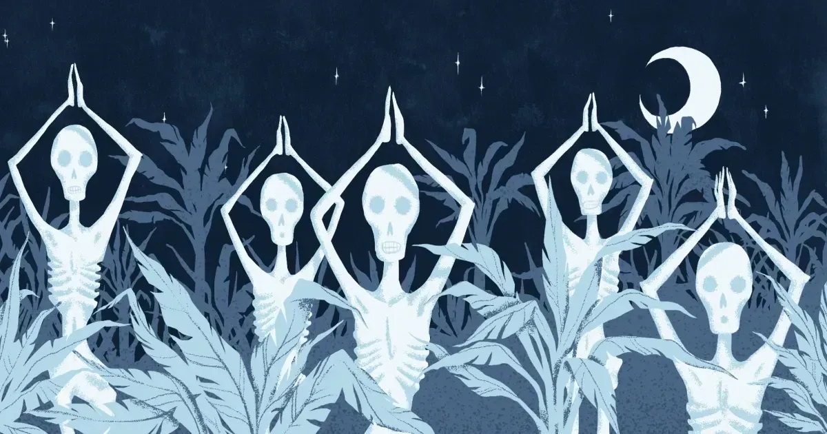
Ghosts in Thai Folklore
Thai spirits or ghosts are known as phi (ผี).
Many have Buddhist origins mixed with legends of spirits or ghosts of local folklore.
Traditionally ghosts were not represented in paintings or drawings, purely based on oral tradition (storytelling).
Ghosts are believed to frequent, certain trees, burial grounds near Buddhist temples, as well as abandoned houses.
They’ve been adapted to modern media, such as Thai films, soap operas, and comics.

Slide 6

02
Process & Code Overview

Slide 7
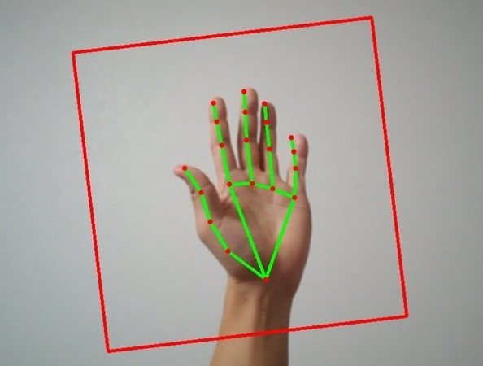
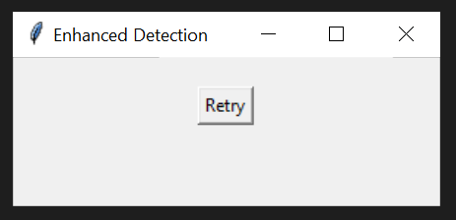
Code: Key Components
Libraries Used
1
2
cv2: For video capture and frame processing.
mediapipe: For detecting and mapping body landmarks.
3
4
numpy: For efficient mathematical operations (rotation, etc.).
Tkinter: To create a simple GUI for video file selection.

Slide 8
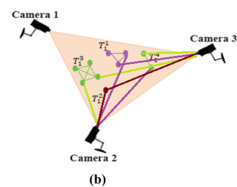
Code: Key Components
Functions Used
1
2
process_video():
Reads frames, and visualizes key points.
select_video_file():
Allows user-friendly video selection via a GUI.
3
4
process_video_with_multiple_angles():
Reprocesses video at different angles for comprehensive detection.
rotate_image():
to process frames from different angles, improving accuracy

Slide 9
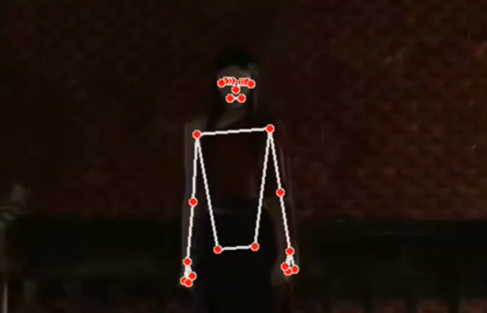
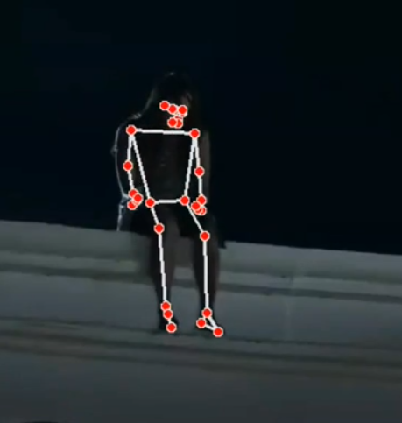
Process Flow: How the Code Runs
File Selection: Tkinter-based dialog
Video Processing: video processed frame by frame.
Pose Detection: algorithm locates body landmarks.
Multi-angle Approach: different angles (0°, 90°, 180°, 270°) for complex camera angles in horror scenes.

Slide 10
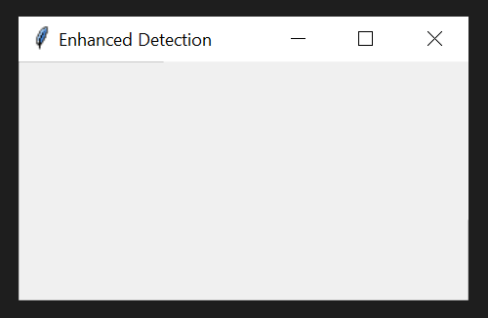
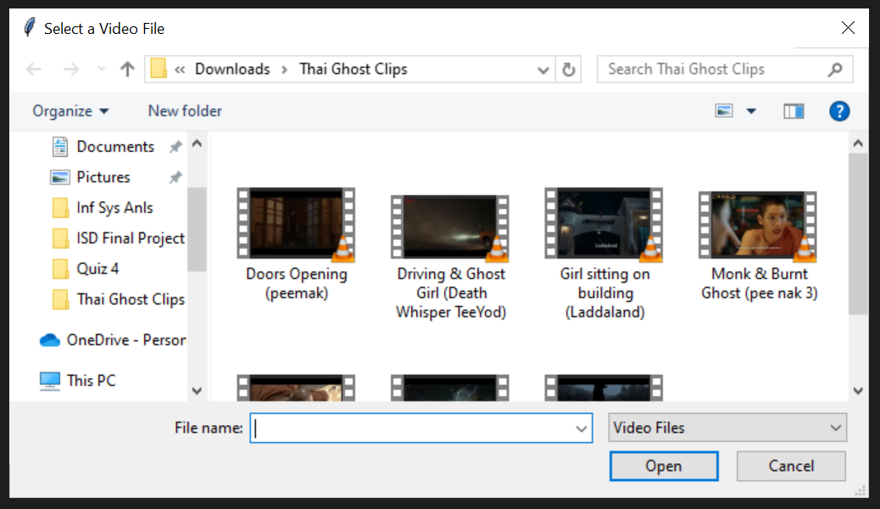

GUI for Video File Selection
After Video Processing

Slide 11

03
Films & Media Chosen Clips

Slide 12
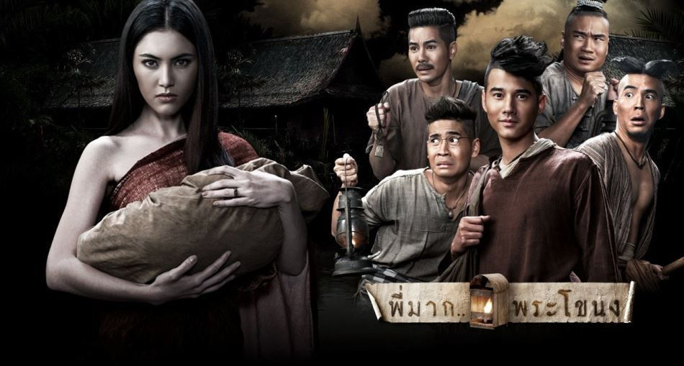
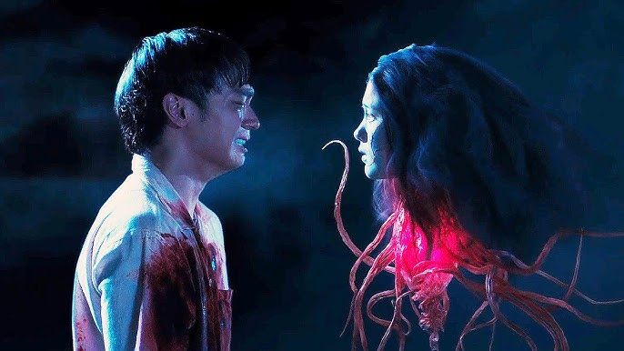
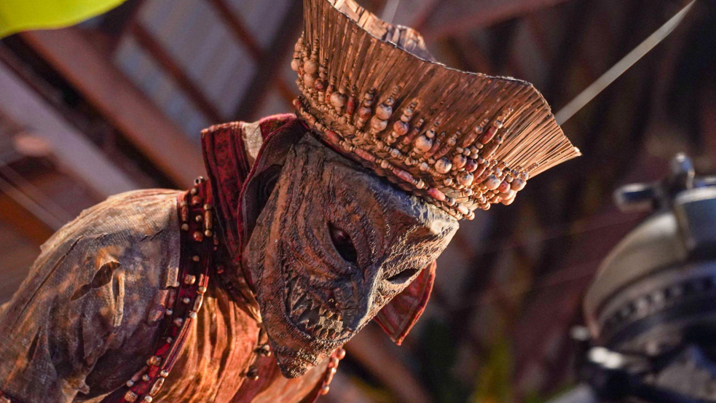
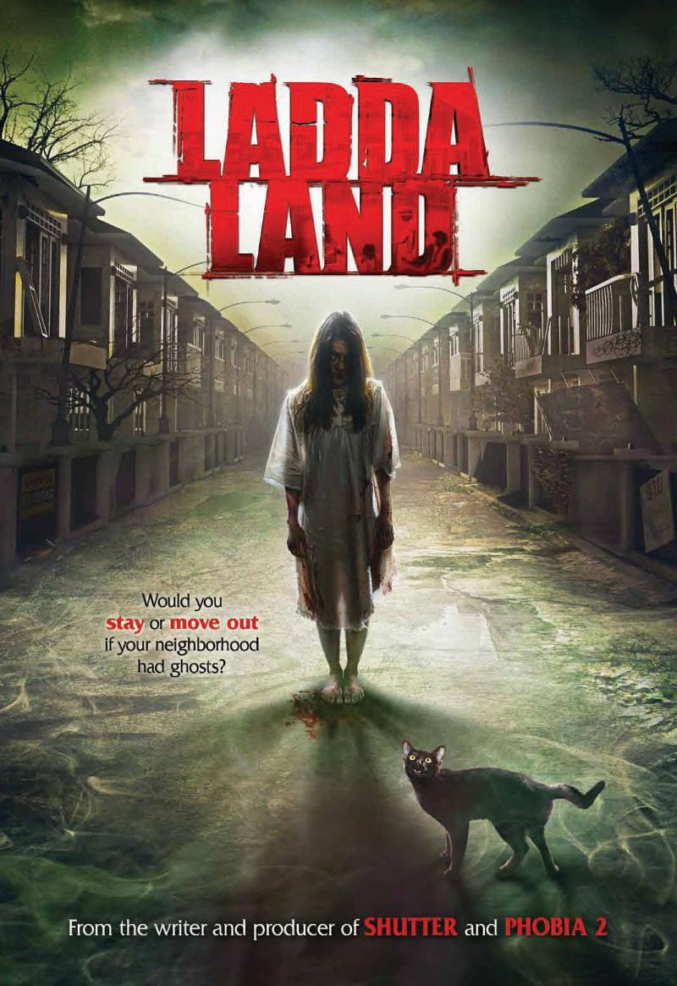
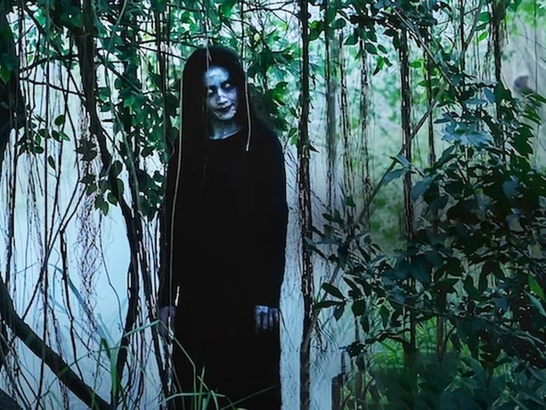
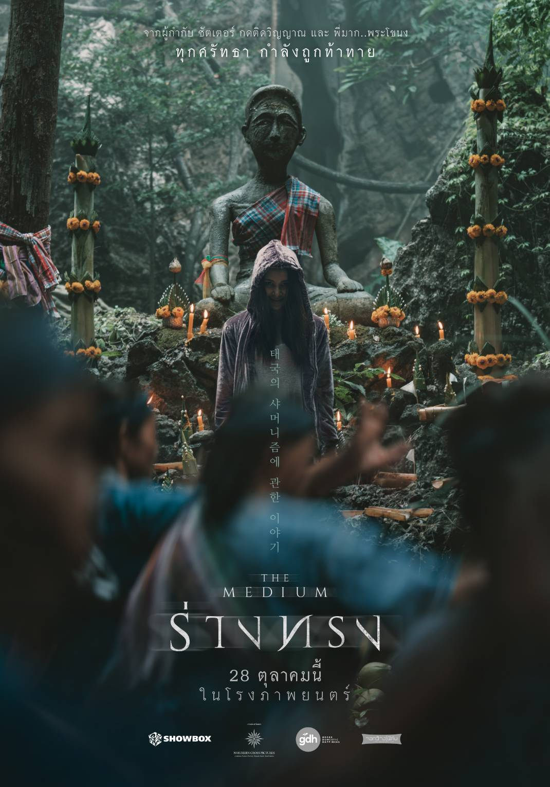
Chosen Film/Media
Pee Mak
Inhumane Kiss
Pee Nak 3 & 4
Laddaland
Death Whisperer
The Medium

Slide 13
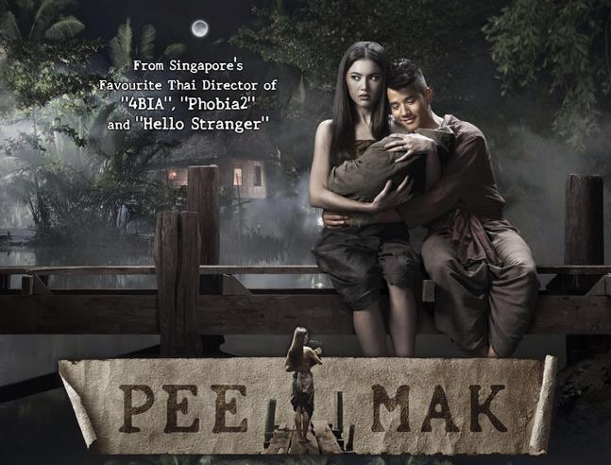
Ghost 1: Mae Nak Phra Khanong
FILM: Pee Mak
Ghost Legend
Story follows a young pregnant woman named Nak
Her husband Mak is sent to war, during which Nak and their child die during childbirth.
When Mak returns home his wife and child are there waiting for him.
He find out that he is living with a ghost; he runs away to a temple
A powerful monk captures Nak's ghost; in a jar, then throws it into the Phra Khanong canal.

Slide 14
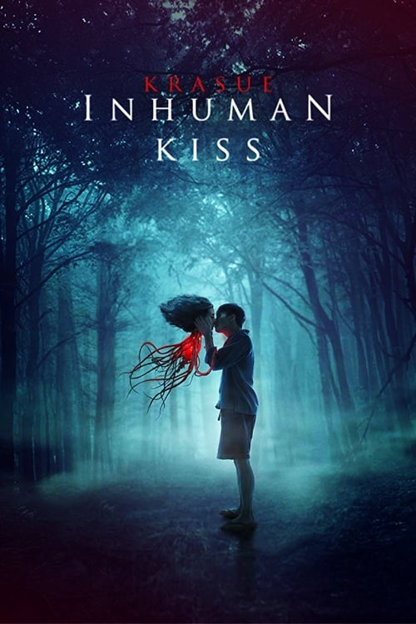
Ghost 2: Krasue
FILM: Inhuman Kiss
Krasue is believed to be a cursed individual (usually a female) who manifests as a disembodied woman's head with organs and entrails hanging from its neck
In Inhuman Kiss, a girl named Sai inherits the curse of the Krasue, forcing her to live a double life.
Her childhood friends discover her secret, they must choose between protecting her or joining a village hunt to kill the creature she has become.

Slide 15
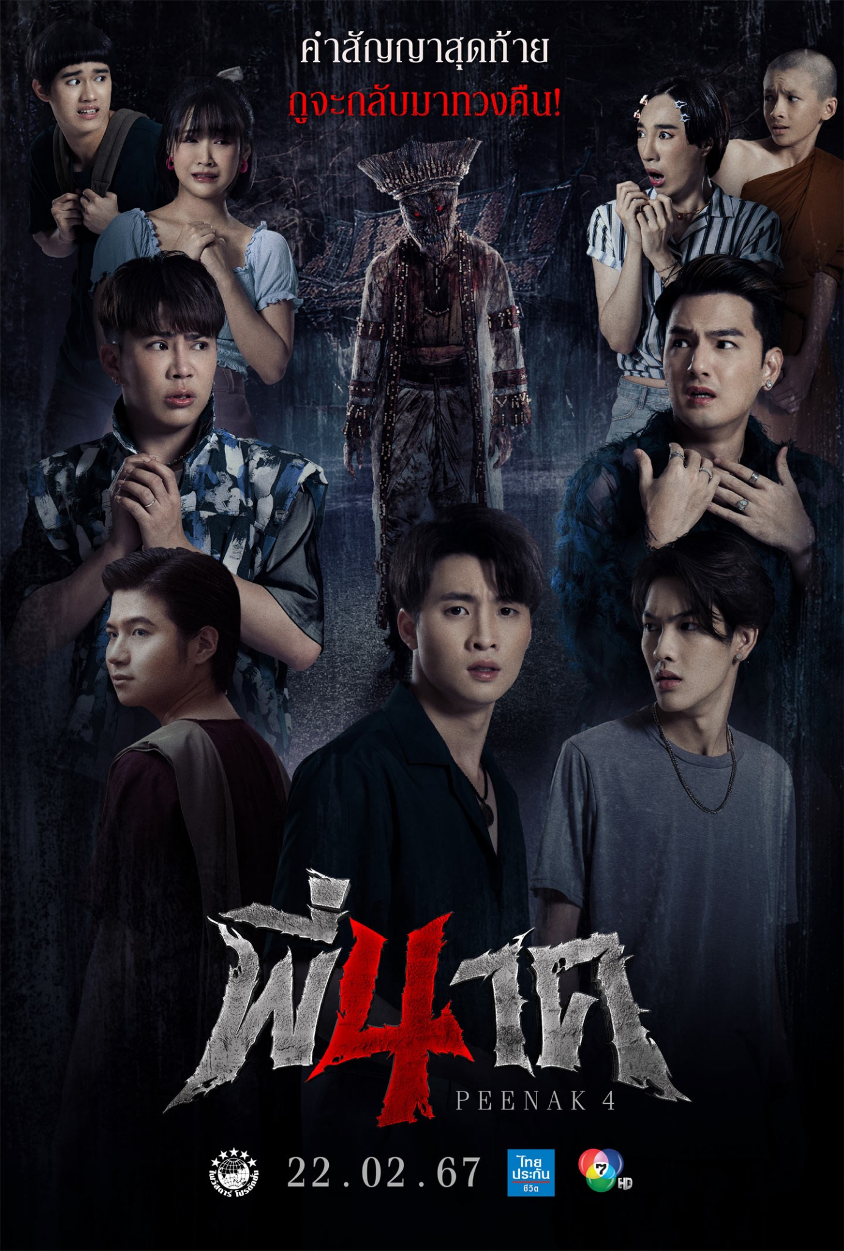
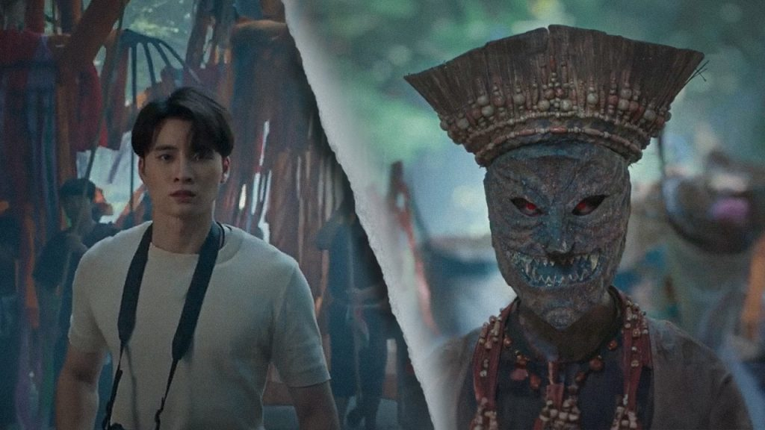
Ghost 3: Phi Ta Khon
Thai Festival - Phi Ta Khon
A parade/festival where people wear masks and costumes to represent spirits (a celebration)
The ghost is based on the spirit of a cursed monk
The Nak (novice monk) spirit failed to complete their monkhood, leading to hauntings within temples or sacred places. This folklore blends Buddhist beliefs with ghostly revenge.
FILM: Pee Nak 3 & 4

Slide 16
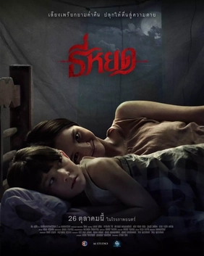
Other Ghosts/Clips
Laddaland
Death Whisperer
The Medium
Chao Kam Nai Wen
(เจ้ากรรมนายเวร)
A ghost that haunts a person or place due to wrongful karma the committed during the ghosts life.
Pop (ปอบ,) & Tee Yod
a mysterious woman in black dress & a cannibalistic spirit of Thai folklore
A demonic possession centered around the belief in shamanism practised in the northeastern part of Thailand.

Slide 17
04
Video Demonstration

Slide 18
Note About Clips Chosen
 | Short Clips | In horror films the ghost doesn’t appear for long (i.e jump scares)
 | Speed | Clips have been slowed down for the program to map body landmarks
 | Deformation | Code works best on human-like ghosts (difficult to detect masks, hidden faces, monsters)
 | Singular Figures | Code detects main character in frame (in clips of more than 1 person, it switches focus)

Slide 19
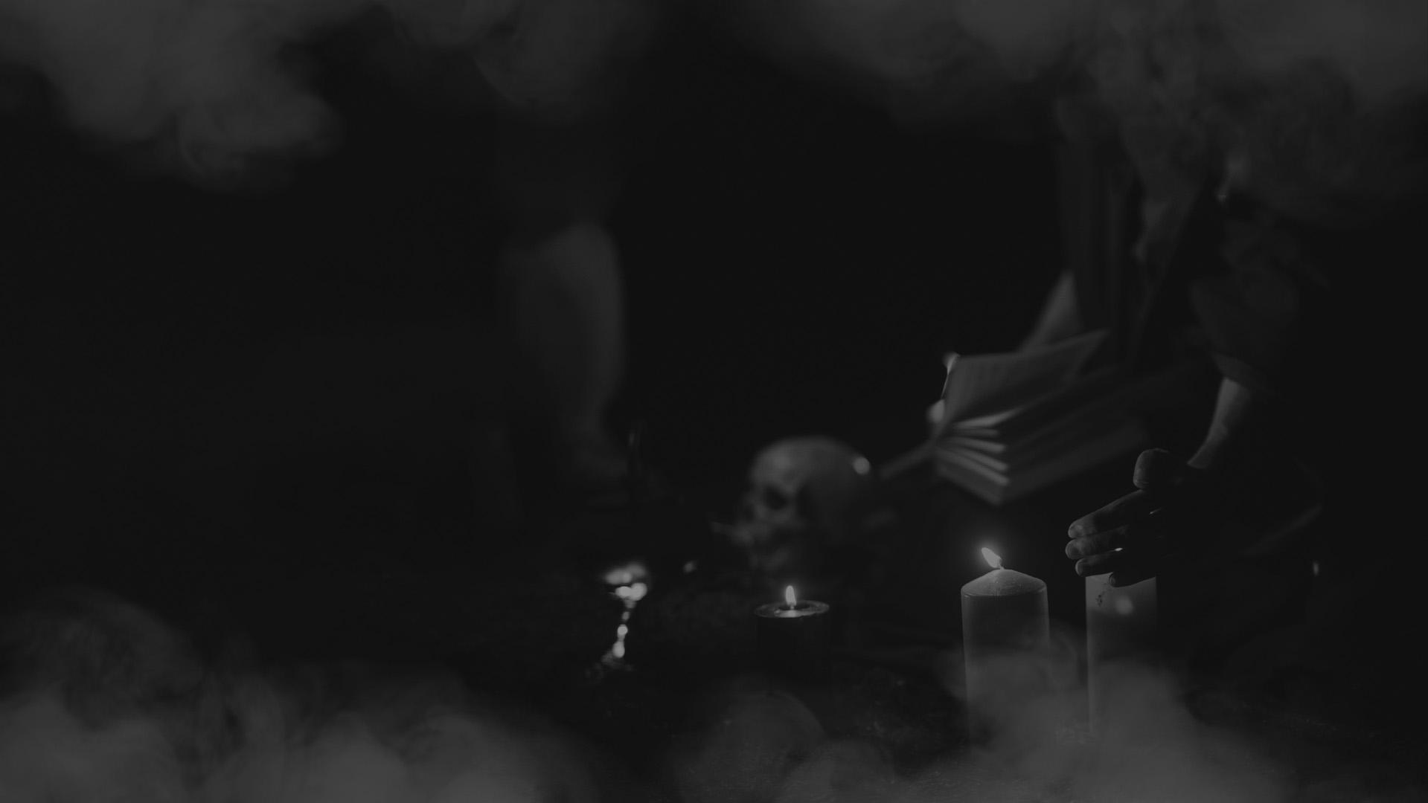
Thank You!

